Slide 1
^{Authority Board Meeting} ^{July 22, 2020} ^{Amendment 2 Outreach Update}
Authority Board Meeting, June 22, 2020 - Draft, Subject to Change
1

Slide 2
Participation Update (Updated 7/20/2020)
Participant | Amendment 2 Agreement Status | Phase 2 (2019) Level (Ref, AF) | Participation Level (AF) Staff Recommendation | Variance (AF) | Increase Interest (AF)
Antelope Valley East Kern WA |  | 500 | 500 | 0
Carter Mutual Water Company |  | 300 | 300 | 0
City of American Canyon | To City Council Aug 18 | 4,000 | 4,000 | 0
Coachella Valley Water District | To Board Sep 8 | 10,000 | 10,000 | 0
Colusa County | Approved | 10,000 | 10,000 | 0
Colusa County WD** | Current Landowners at 6,000AF | 11,975 | 6,000 | -5,975 | Possibly
Cortina WD |  | 450 | 450 | 0
Davis Water District | To Board first week of August | 2,000 | 2,000 | 0
Dunnigan WD |  | 2,717 | 2,717 | 0
Desert WA | No Board Date Set | 6,500 | 6,500 | 0
Glenn Colusa Irrigation District | To Board Workshop Aug 20 | 5,000 | 5,000 | 0
LaGrande Water District |  | 1,000 | 1,000 | 0
Metropolitan Water District of Southern California | To Board in October | 50,000 | ​50,000 | 0​ | ​
RD-108​ | Approved​ | 4,000​ | 4,000​ | 0​ | ​
Continued on next slide
Authority Board Meeting, June 22, 2020 - Draft, Subject to Change
Notes:
Thank everyone for their responses.
Summary of Attachment A and survey results, key takeaways.

Slide 3
Continued from previous slide
Participant | Amendment 2 Agreement Status | Phase 2 (2019) Level (Ref, AF) | Participation Level (AF) Staff Recommendation | Variance (AF) | Increase Interest (AF)
San Bernardino Valley Municipal Water District​ | Approved​ | 21,400​ | 21,400​ | 0​ | ​
San Gorgonio Pass Water Agency​ | 10,000AF SGPWA Approved, 4,000 AF Retailer TBD​ | 14,000​ | 14,000​ | 0​ | ​
Santa Clara Valley WD***​ | No Board Date Set​ | 16,000​ | Pending​ | 0​ | ​
Santa Clarita Valley Water Agency​ | To Board Jul 21​ | 5,000​ | 5,000​ | 0​ | 5,000​
Westside W.D.**​ | Prop 218 for 2,000AF in Process, ind. Landowner Outreach in Process​ | 15,000​ | 2,000​ | -13,000​ | Possibly​
Zone 7 Water Agency​ | Approved​ | 10,000​ | 10,000​ | 0​ | ​
Wheeler Ridge-Maricopa WSD​ | Investor Workshop Jul 27, Responses Due Aug 7, Board Meeting Aug 12​ | 3,050​ | 3,050​ | 0​ | ​
Pacific Resources MWC | Attending Wheeler Ridge Workshop Jul 27​ | 0​ | 0​ | 0​ | 10,000​
Total​ | ​ | 192,892​ | 173,917​ | -18,975​ | 15,000​

Slide 4
^{bullpen}
Authority Board Meeting, June 22, 2020 - Draft, Subject to Change
4

Slide 5
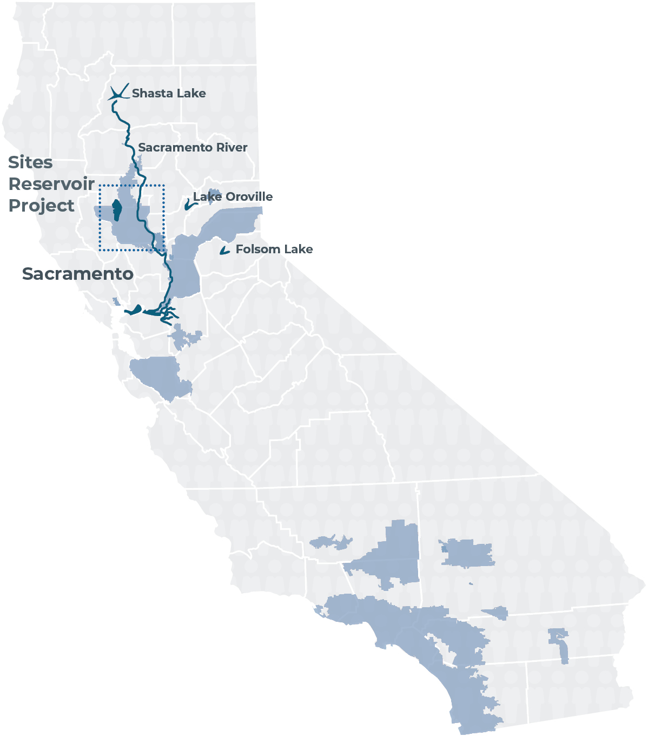
Geographic Balance
Total: 192,892
Total: 188,917
Authority Board Meeting, June 22, 2020 - Draft, Subject to Change
Notes:
Projections include some important assumptions:
Conservative values used (worst cases) for Sac Valley reductions. (Westside doesn’t increase beyond their board position of 2,000AF)
Participants who have not responded will maintain existing participation levels.
Other interested parties, which are both outside of the Sac Valley, pick up around 15,000 AF.

