Slide 1
Welcome – Zoom Protocols
When logging in to Zoom, log in first with your computer. If you are using a separate phone line for audio, please enter your participant ID when you dial in.
Please remain muted until called upon by the moderator.
Authority Board and Reservoir Committee members and alternates, to offer a comment or discussion, Raise Hand or use the Chat feature.
  Raise Hand is available in the Participants window.
  Chat is available in the Chat window.
If you have technical issues, send a Chat to a co-host and we will try to help.

Slide 2
Sites Project Authority
Roll Call
Public Comment

Slide 3


Congratulations on the Sites Project Authority
10 Year Anniversary

Slide 4
10 Year Anniversary

Slide 5



Strategic Plan

Slide 6
Strategic Plan Approach
Gather Input
Identify and Refine High-Priority Goals & Objectives
Refine Implementation Strategies
Identify Performance Measures and Progress Reporting

Slide 7
Input
Board
Agents & Select Consultants
Reservoir Committee

Slide 8
Today’s Discussion Goals
Affirm revised Vision, Mission, Values to guide the organization
Discuss and affirm high-level goals and objectives to focus the work
Discuss and receive guidance on the strategies to achieve the goals

Slide 9
Agenda for the Day
Introductions – Goals for the Day
Strategic Planning Context – Input to Date
Mission, Vision, Values
Goals & Objectives
Deeper Dive on Goals & Objectives – Breakout Groups
Next Steps

Slide 10
Zoom Protocols
Please remain muted until called upon by the moderator.
Authority Board and Reservoir Committee members and alternates, to offer a comment or discussion, Raise Hand or use the Chat feature.
  Raise Hand is available in the Participants window.
  Chat is available in the Chat window.
If you have technical issues, send a Chat to a co-host and we will try to help.
In the afternoon breakout sessions, we will be using an online collaboration platform. You will receive a link in the breakout session.

Slide 11
Discussion Protocols
Be patient. Virtual meeting technology is imperfect.
Use Raise Hand at anytime; you’ll be recognized to speak.
Lean toward brevity, but feel free to complete your thoughts.
We wish to avoid groupthink: divergent views are encouraged.

Slide 12
Goals for the Day
Introductions – Name, Organization, Your Goals for Today
American Canyon | San Bernardino Valley Municipal Water District
Antelope Valley - East Kern Water Agency | San Gorgonio Pass Water Agency
Carter Mutual Water Company | Santa Clara Valley Water District
City of Sac/Sacramento County | Santa Clarita Valley Water District
Coachella Valley Water District | TC-4 Districts
Colusa County | TC4: Cortina Water District
Colusa County Board of Supervisors | TC4: Davis Water District
Colusa County Water Agency | TC4: Dunnigan Water District
Colusa County Water District | TC4: LaGrande Water District
Desert Water Agency | Tehama-Colusa Canal Authority
Glenn County Board of Supervisors | Western Canal Water District
Glenn-Colusa Irrigation District | Westside Water District
Metropolitan Water District | Zone 7 Water Agency
Placer County & City of Roseville | Bureau of Reclamation
Reclamation District 108 | CA Department of Water Resources

Slide 13

Why a Strategic Plan?
Align Purpose and Activities for the Project and Organization
Set Direction for 3 to 5 Years
Illuminate Important Issues and Challenges
Develop Consistent Language and Approach for Decision-making
Define Organizational Performance and Progress

Slide 14
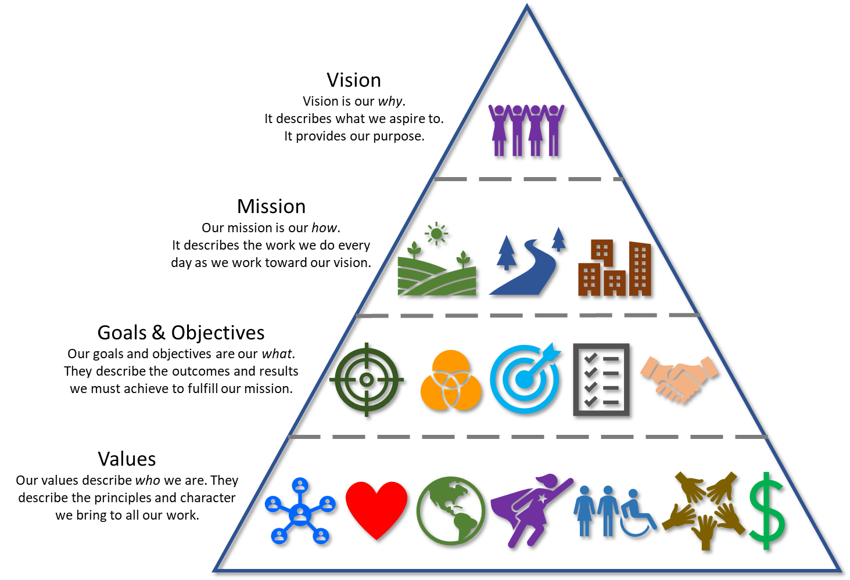
Strategic Planning
Framework
Challenges, Risks & Uncertainties
Partners & Commitments
Activities & Milestones
Progress & Performance
Adapted from Territory.co

Slide 15
What We Heard – Qualitative Input
The Authority and Project are in transition
  From project development to owner-led infrastructure investment
Value Planning transformed the project and the partnership
  Affordable project; stronger partnership
Management, communication, and trust are improving
  New leadership; better issue management
A lot to accomplish in the next 18 months
  Everyone seeking more certainty

Slide 16
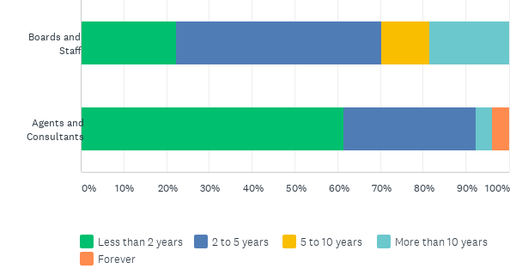
What We Heard – Survey Results
54 Total Responses
  28 Boards and Staff
  26 Agents and Consultants
How long have you been working on the Sites Project?
81%

Slide 17
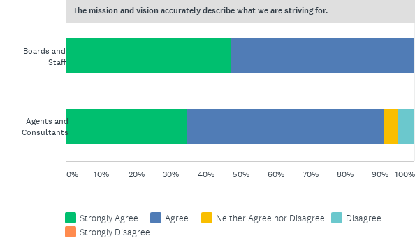
The mission and vision accurately describe what we are striving for.
95%

Slide 18
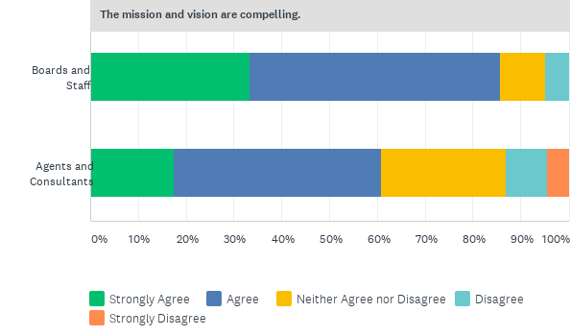
The mission and vision are compelling.
73%

Slide 19
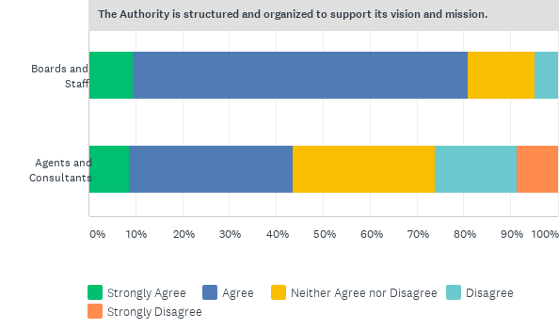
The Authority is structured and organized to support its vision and mission.
61%

Slide 20
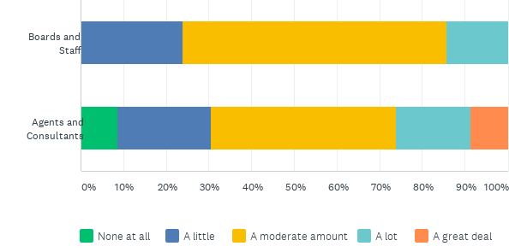
The Authority is in a time of transition. Generally, what degree of change do you believe is required for the Authority to fulfill its mission?
Answered: 44 Skipped: 10
73%

Slide 21
Please rank in order the following functions of the Authority from strongest to weakest.

Slide 22
Which of the following functions should the Authority improve/strengthen to fulfill the mission?

Slide 23
What do you see as the greatest challenges for the Authority in the next three to five years?
Permitting
Funding & financing
  Agreements with participants
  Federal & state participation
Politics & uncertainties
Budget, increasing phase costs, affordability
Communications, negotiations, partnerships, NGO buy-in
Governance and decision-making
Schedule, managing everything
Transitioning the organization, teamwork & turnover
40 Responses

Slide 24
How important is each of the following objectives for the Authority?

Slide 25
What other goals or objectives should be considered in the strategic plan?
25 Responses
Partnerships
Financial Plan
Affordability and Cost Controls
DSOD Permits
Property Access
Legal Defensibility
Communicate Joint Benefits
Project Spokespeople
Representative for the Environment
Governance & Decision-making
Strategic Plan
Culture, Values, and Team
Succession Plan
Consultant Streamlining
25 Responses

Slide 26
How could the Authority function more effectively or efficiently?
Plan and act strategically
Open communications, transparency
Streamline decision-making while maintaining participation
Delegate decisions
Joint workshops, in-person meetings
Program management model
Fewer consultants, get new ones up to speed, break down silos
Chief engineer
Fund effort accordingly
Environmental engagement
34 Responses

Slide 27
Do the Authority’s structure and decision-making need to evolve as the project develops?
34 Responses – 28 said Yes, 1 said not until operations, 1 said it will evolve naturally
Be more nimble, action-oriented
Delegate decisions
Executive Board
Committee on financing plan
Evolve through stages
Focus on participant buy-in, public/political affairs
Adapt to evolving needs for environmental review and permitting

Slide 28
Please provide any additional ideas and recommendations.
All Board and RC members involved in outreach
Tell the story
Reservoir Committee identity and culture
Address different perspectives on costs
Work group leadership
Reconsider Integrator role
Focus our efforts
Complete small projects that contribute to ultimate completion
Mature the organization
Celebrate success
Sites could be a modern success story!
20 Responses

Slide 29
Questions
Purpose & Agenda
Strategic Plan Structure
Initial Findings

Slide 30
Breakout Groups
Until 1:30
Breakout 1 – Goal 1. Secure Commitments for Project Funding
  Remain here
Breakout 2 – Goal 2. Secure the Agreements and Permits Necessary to Build and Operate a Multi-Benefit Reservoir
  Raise Hand and we will move you to that group
1:30 to 2:15
Goal 4. Strengthen the Organization as the Owner of a $3.5 Billion Project
  Both breakout groups will discuss this Goal
2:15
Reconvene, Next Steps, and Close

Slide 31
Sites Strategic Plan
Challenges, Risks & Uncertainties
Partners & Commitments
Activities & Milestones
Progress & Performance
Adapted from Territory.co

Slide 32
Strategic Plan

